Slide 1
Unit -1
Introduction Database Concepts

Slide 2
Outline of Unit 1
Introduction, Characteristics of databases
File system v/s Database system
Users of Database system
Data Independence
DBMS system architecture
Database Administrator

Slide 3
Database Management System
Database: A collection of related data. It should support
  Definition
  Construction
  Manipulation
Database Management System: A collection of programs that enable the users to create and maintain a database.

Slide 4
Database Management System
Data: Known facts that can be recorded and have an implicit meaning; raw
Database: a highly organized, interrelated, and structured set of data about a particular enterprise
  Controlled by a database management system (DBMS)
DBMS
  Set of programs to access the data
  An environment that is both convenient and efficient to use
Database systems are used to manage collections of data that are:
  Highly valuable
  Relatively large
  Accessed by multiple users and applications, often at the same time.
A modern database system is a complex software system whose task is to manage a large, complex collection of data.
Databases touch all aspects of our lives

Slide 5
Database Management System
Database:
  A collection of related data.
Data:
  Known facts that can be recorded and have an implicit meaning.
Mini-world:
  Some part of the real world about which data is stored in a database. For example, student grades and transcripts at a university.
Database Management System (DBMS):
  A software package/system to facilitate the creation and maintenance of a computerized database.
Database system:
  The DBMS software together with the data itself. Sometimes, the applications are also included.

Slide 6
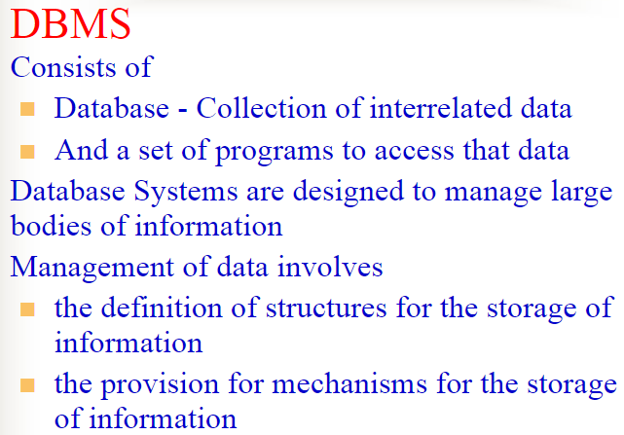
Introduction:

Slide 7
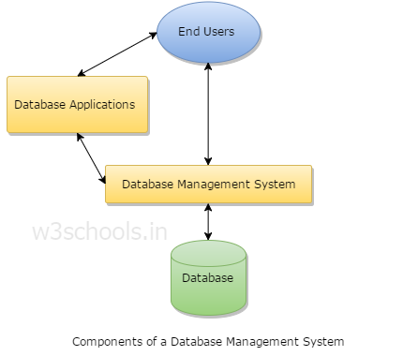
Components of DBMS

Slide 8
Database Management System (DBMS)
Collection of interrelated data
Set of programs to access the data
DBMS contains information about a particular enterprise
DBMS provides an environment that is both convenient and efficient to use.
Database Applications:
  Banking: all transactions
  Airlines: reservations, schedules
  Universities: registration, grades
  Sales: customers, products, purchases
  Manufacturing: production, inventory, orders, supply chain
  Human resources: employee records, salaries, tax deductions
Databases touch all aspects of our lives

Slide 9
Introduction
DBMS tasks:
  Managing large quantity of structured data
  Efficient retrieval and modification: query processing and optimization
  Sharing data: multiple users use and manipulate data
  Controlling the access to data: maintaining the data integrity

Slide 10
Introduction
An example of a database (relational):
  Relations (tables)
  Attributes (columns)
  Tuples (rows)
  Example query: Salesperson='Mary' AND Price>100.

Slide 11
Purpose of Database System
In the early days, database applications were built on top of file systems
Drawbacks of using file systems to store data:
  Data redundancy and inconsistency
    Multiple file formats, duplication of information in different files
  Difficulty in accessing data
    Need to write a new program to carry out each new task
  Data isolation — multiple files and formats
  Integrity problems
    Integrity constraints (e.g. account balance > 0) become part of program code
    Hard to add new constraints or change existing ones

Slide 12
Purpose of Database Systems (Cont.)
Drawbacks of using file systems (cont.)
  Atomicity of updates
    Failures may leave database in an inconsistent state with partial updates carried out
    E.g. transfer of funds from one account to another should either complete or not happen at all
  Concurrent access by multiple users
    Concurrent accessed needed for performance
    Uncontrolled concurrent accesses can lead to inconsistencies
      E.g. two people reading a balance and updating it at the same time

Slide 13
Purpose of Database Systems (Cont.)
Drawbacks of using file systems (cont.)
  Security problems
  Data should be secured from unauthorized access.
Database systems offer solutions to all the above problems

Slide 14
Advantage of DBMS over file system
No redundant data: Redundancy removed by data normalization.
Data Consistency and Integrity: since data normalization takes care of the data redundancy, data inconsistency also been taken care of as part of it.
Data Security: Each user has a different set of access thus data is secured from the issues such as identity theft, data leaks and misuse of data.
Privacy: Limited access means privacy of data.

Slide 15
Advantage of DBMS over file system
Easy access to data – Database systems manages data in such a way so that the data is easily accessible with fast response times.
Easy recovery: Since database systems keeps the backup of data, it is easier to do a full recovery of data in case of a failure.
Flexible: Database systems are more flexible than file processing systems.

Slide 16
Disadvantage of DBMS over file system
DBMS implementation cost is high compared to the file system
Complexity: Database systems are complex to understand
Performance: Database systems are generic, making them suitable for various applications. However this feature affect their performance for some applications

Slide 17
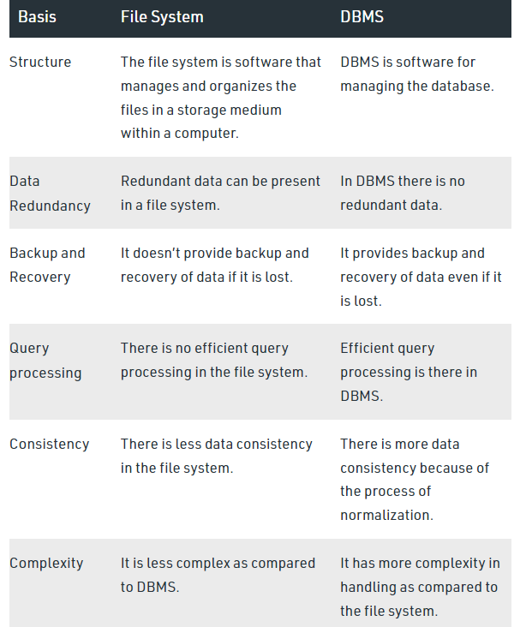
File system v/s Database system

Slide 18
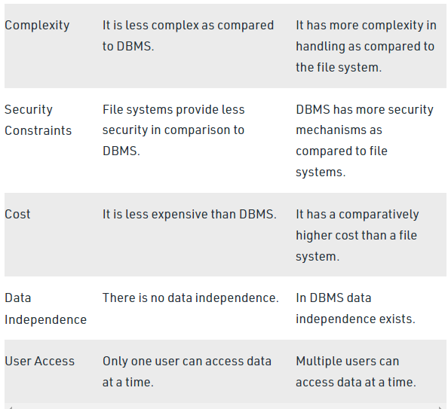
File system v/s Database system

Slide 19
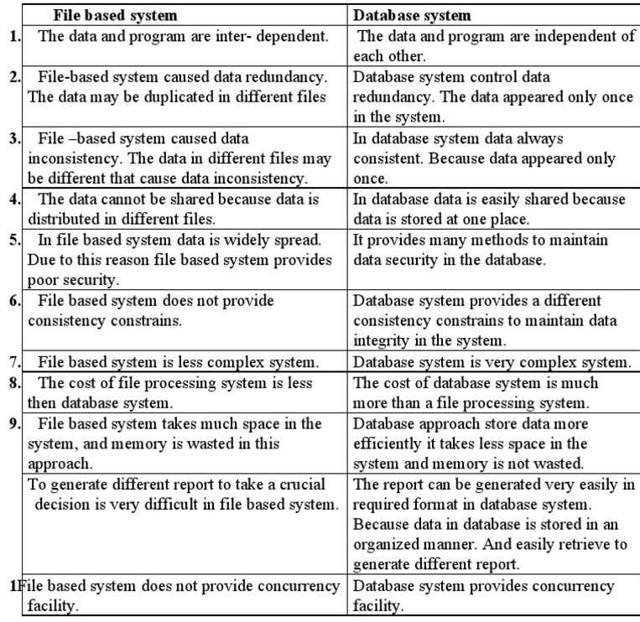
File system v/s Database system

Slide 20
Features of DBMS
Data storage, retrieval, and update: The ability to store, retrieve, and update the data that are in the database.
User-accessible catalog: where descriptions of database components are stored and are accessible to the users
Shared update support: A mechanism to ensure accuracy when several users are updating the database at the same time

Slide 21
Features of DBMS
Backup and Recovery Services: Mechanisms for recovering the database in the event that a database is damaged somehow.
Security Services: Mechanisms to ensure that certain rules are followed with regard to data in the database and any changes that are made in the data

Slide 22
Features of DBMS
Integrity services: Mechanisms to ensure that certain rules are followed with regard to data in the database and any changes that are made in the data.
Data Independence: Facilities to support the independence of programs from the structure of the database.
Replication support: A facility to manage copies of the same data at multiple locations.
Utility Services: DBMS provided services that assist in the general maintenance of the database.

Slide 23
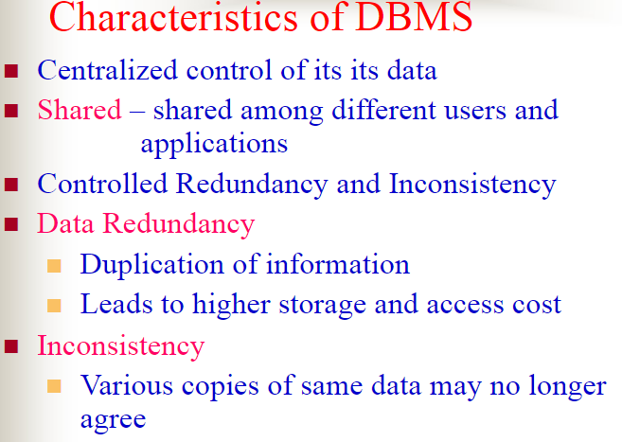

Slide 24
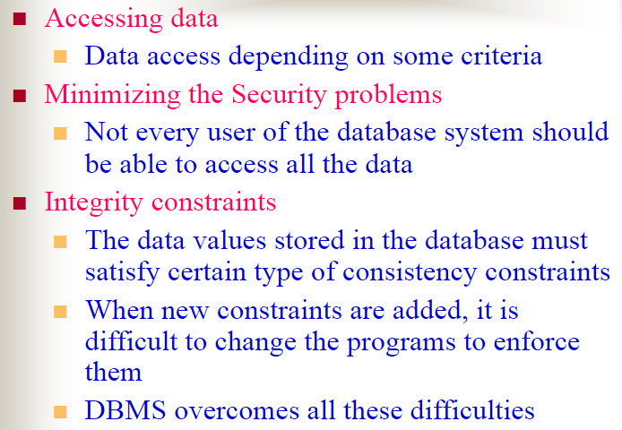

Slide 25
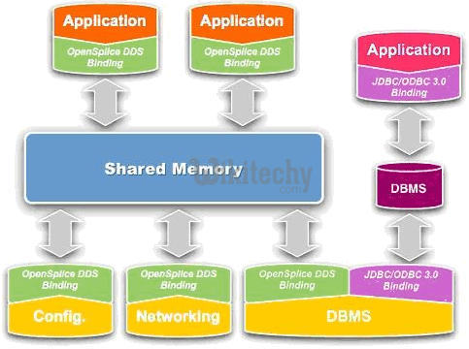
Shared-
Shared amongst different users and applications

Slide 26
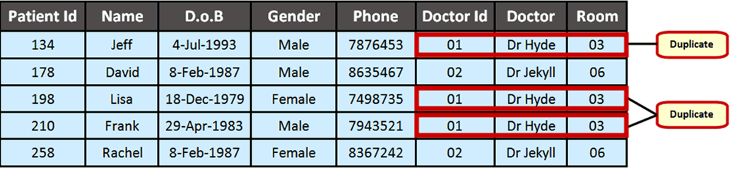
Data Redundancy –
Same information may be duplicated in several places

Slide 27
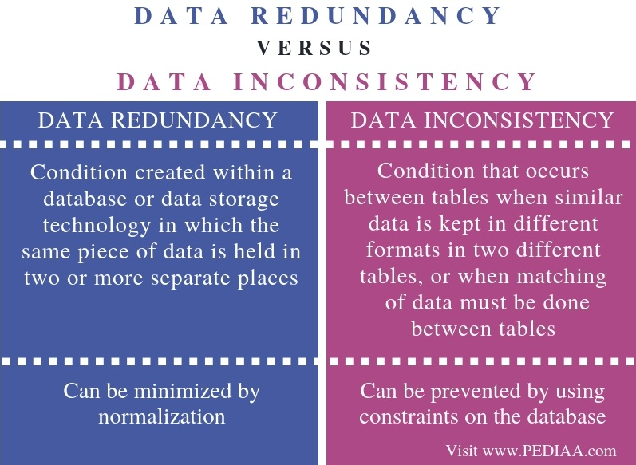
Inconsistency:
Data inconsistency is a situation where there are multiple tables within a database that deal with the same data but may receive it from different inputs.

Slide 28
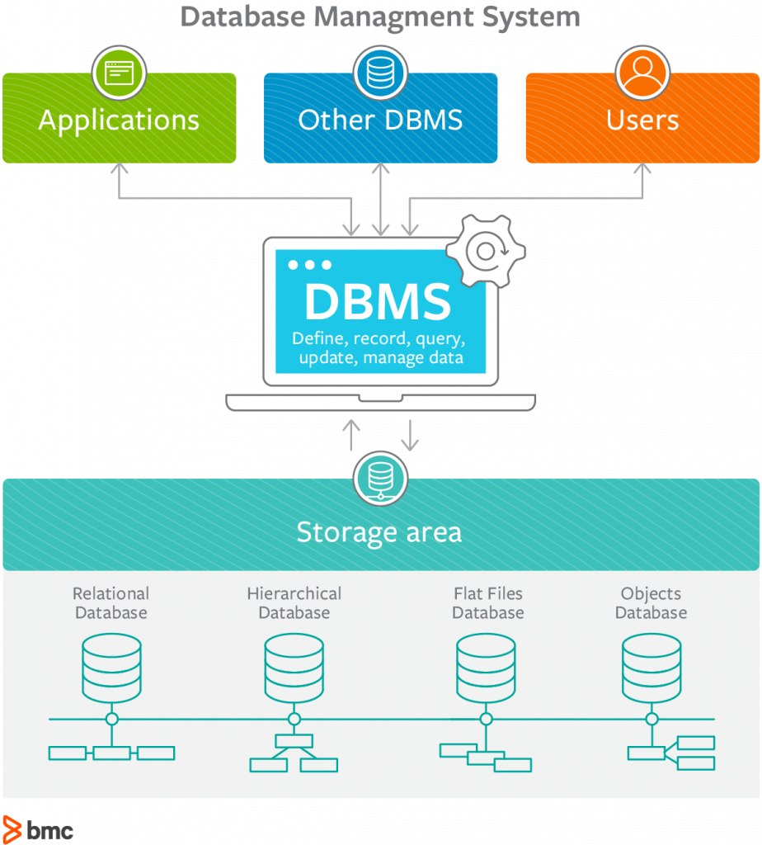
Accessing Data:
Users who have data access can store, retrieve, move or manipulate stored data

Slide 29
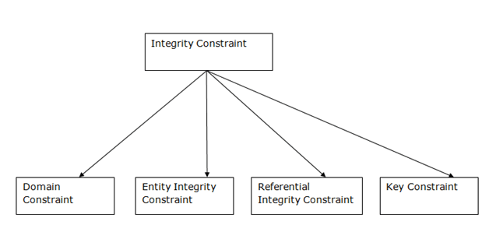
Integrity Constraints
Integrity constraints are a set of rules.

Slide 30
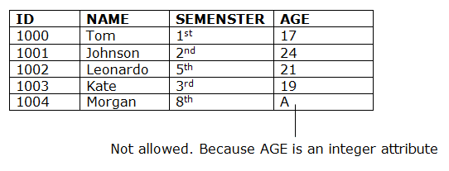
1.Domain Constraints
Domain constraints can be defined as the definition of a valid set of values for an attribute.

Slide 31
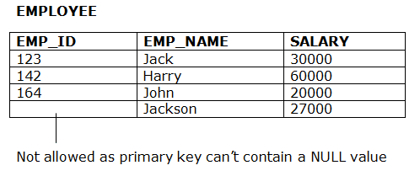
2.Entity integrity constraints
The entity integrity constraint states that primary key value can't be null.

Slide 32
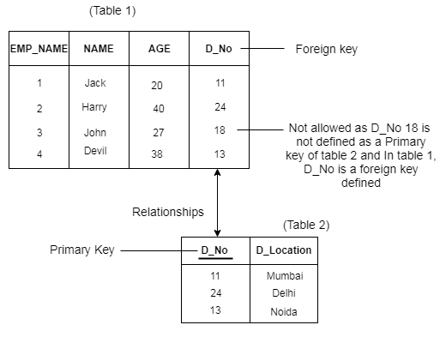
3.Referential Integrity Constraints
A referential integrity constraint is specified between two tables.

Slide 33
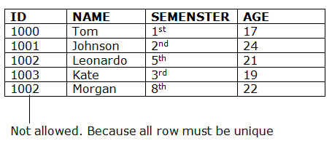
4. Key Constraints
Keys are the entity set that is used to identify an entity within its entity set uniquely.

Slide 34
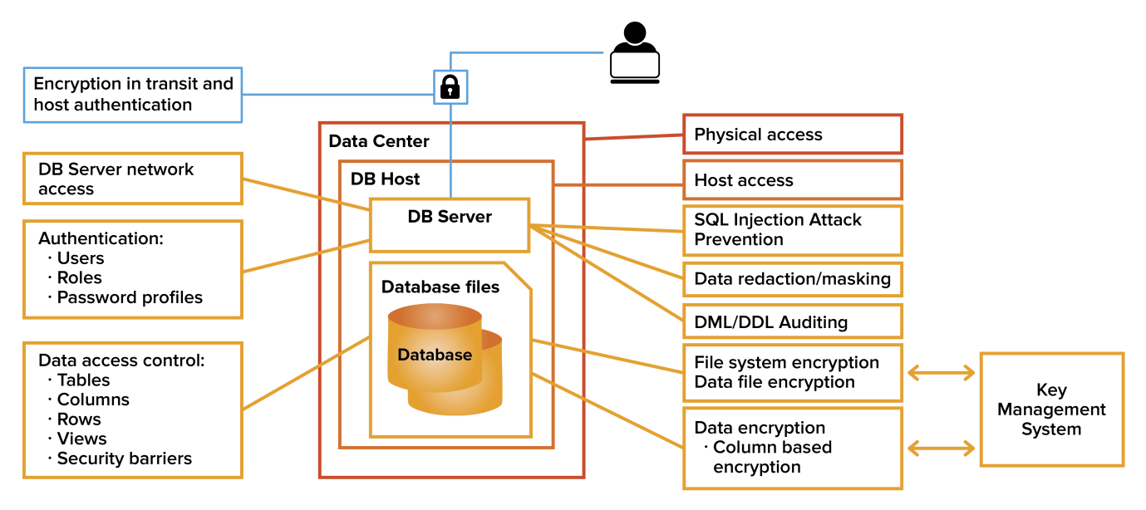
Minimizing the Security problems:
Not every user of the database system should be able to access all the data.

Slide 35
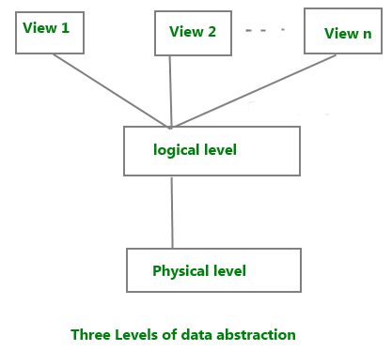
Data Abstraction in DBMS
Database systems are made-up of complex data structures.

Slide 36
Levels of Abstraction
Physical level describes how a record (e.g., customer) is stored.
Logical level: describes data stored in database, and the relationships among the data.
type customer = record
name : string;
street : string;
city : integer;
end;
View level: application programs hide details of data types. Views can also hide information (e.g., salary) for security purposes.

Slide 37


An architecture for a database system

Slide 38
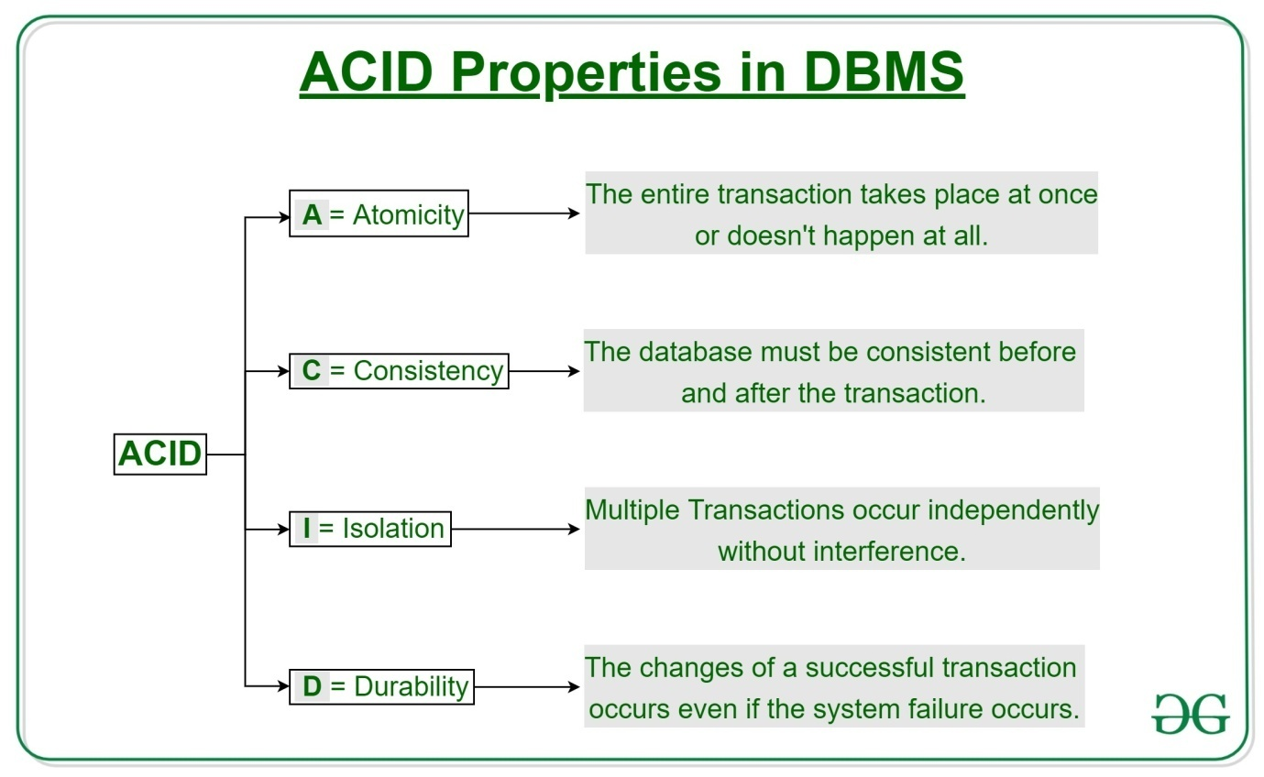

Slide 39
Users of Database system
Database users are categorized based up on their interaction with the data base.
Database Administrator (DBA)
Naive / Parametric End Users
System Analyst
Sophisticated Users
Data Base Designers
Application Program
Specialized users
Casual Users / Temporary Users

Slide 40
Users of Database system
Database Administrator (DBA)
Database Administrator (DBA) is a person/team who defines the schema and also controls the 3 levels of database.
The DBA will then create a new account id and password for the user if he/she need to access the data base.

Slide 41
Users of Database system
Naive Users :
Users are the unsophisticated who don’t have any DBMS knowledge but they frequently use the data base applications in their daily life to get the desired results.
System Analyst :
System Analyst is a user who analyzes the requirements of parametric end users. They check whether all the requirements of end users are satisfied.

Slide 42
Users of Database system
Sophisticated Users :
- Sophisticated users can be engineers, scientists, business analyst, who are familiar with the database.
- Form requests in a database query language
Data Base Designers :
Data Base Designers are the users who design the structure of data base which includes tables, indexes, views, constraints, triggers, stored procedures.

Slide 43
Users of Database system
Application Programmers:
Interact with system through DML calls
Application Program are the back end programmers who writes the code for the application programs.They are the computer professionals.
Specialized users :
Write specialized database applications that do not fit into the traditional data processing framework

Slide 44
Users of Database system
Casual Users / Temporary Users :
Casual Users are the users who occasionally use/access the data base but each time when they access the data base they require the new information, for example, Middle or higher level manager.

Slide 45
Data Independence
Data independence refers characteristic of being able to modify the schema at one level of the database system without altering the schema at the next higher level.

Slide 46
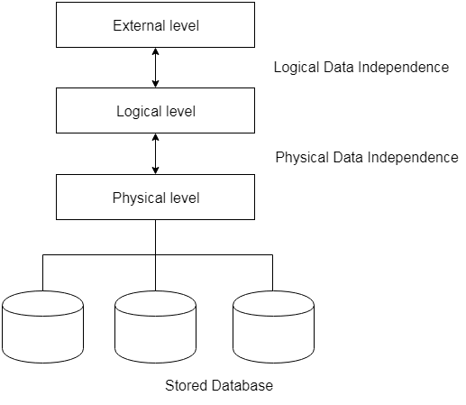
Data Independence
Data independence can be explained using the three-schema architecture.

Slide 47
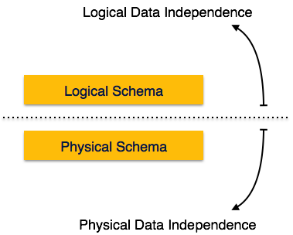
Data Independence
There are two types of data independence:

Slide 48
Data Independence
Logical Data Independence
Logical data is data about database, that is, it stores information about how data is managed inside. For example, a table (relation) stored in the database and all its constraints, applied on that relation.
Physical Data Independence
All the schemas are logical, and the actual data is stored in bit format on the disk. Physical data independence is the power to change the physical data without impacting the schema or logical data.

Slide 49
Instances and Schemas
Similar to types and variables in programming languages
Schema – the logical structure of the database
  e.g., the database consists of information about a set of customers and accounts and the relationship between them)
  Analogous to type information of a variable in a program
  Physical schema: database design at the physical level
  Logical schema: database design at the logical level

Slide 50
Instances and Schemas
Instance – the actual content of the database at a particular point in time
  Analogous to the value of a variable
Physical Data Independence – the ability to modify the physical schema without changing the logical schema
  Applications depend on the logical schema
  In general, the interfaces between the various levels and components should be well defined so that changes in some parts do not seriously influence others.

Slide 51
DBMS Application Architectures
There are three types of DBMS application architecture:
1. Single tier architecture
2. Two tier architecture
3. Three tier architecture

Slide 52
DBMS Application Architectures
1) Single tier architecture -
In this type of architecture, the database is readily available on the client machine, any request made by client doesn’t require a network connection to perform the action on the database.

Slide 53
DBMS Application Architectures
2) Two tier architecture -
In two-tier architecture, the Database system is present at the server machine and the DBMS application is present at the client machine, these two machines are connected with each other through a reliable network as shown in the above diagram.

Slide 54
DBMS Application Architectures
3) Three tier architecture -
In three-tier architecture, another layer is present between the client machine and server machine. In this architecture, the client application doesn’t communicate directly with the database systems present at the server machine

Slide 55


Two-tier architecture: E.g. client programs using ODBC/JDBC to
communicate with a database
Three-tier architecture: E.g. web-based applications, and
applications built using “middleware”

Slide 56
DBMS System Architeture
The architecture of DBMS depends on the computer system on which it runs. For example, in a client-server DBMS architecture, the database systems at server machine can run several requests made by client machine. We will understand this communication with the help of diagrams.

Slide 57



Slide 58
Database Administrator
Coordinates all the activities of the database system; the database administrator has a good understanding of the enterprise’s information resources and needs.

Slide 59
Users of Database system
Database Administrator (DBA)
Database Administrator (DBA) is a person/team who defines the schema and also controls the 3 levels of database.
The DBA will then create a new account id and password for the user if he/she need to access the data base.

Slide 60
Database Administrator
Database administrator's duties include:
  Schema definition
  Storage structure and access method definition
  Schema and physical organization modification
  Granting user authority to access the database
  Specifying integrity constraints
  Acting as liaison with users
  Monitoring performance and responding to changes in requirements

Slide 61
Thank You!

Slide 62
Data Models
A collection of tools for describing
  data
  data relationships
  data semantics
  data constraints
Entity-Relationship model
Relational model
Other models:
  object-oriented model
  semi-structured data models
  Older models: network model and hierarchical model

Slide 63

Entity-Relationship Model
Example of schema in the entity-relationship model

Slide 64
Entity Relationship Model (Cont.)
E-R model of real world
  Entities (objects)
    E.g. customers, accounts, bank branch
  Relationships between entities
    E.g. Account A-101 is held by customer Johnson
    Relationship set depositor associates customers with accounts
Widely used for database design
  Database design in E-R model usually converted to design in the relational model (coming up next) which is used for storage and processing

Slide 65
Relational Model
Example of tabular data in the relational model
Attributes
Customer-id
customer-
name
customer-
street
customer-
city
account-
number
192-83-7465
019-28-3746
192-83-7465
321-12-3123
019-28-3746
Johnson
Smith
Johnson
Jones
Smith
Alma
North
Alma
Main
North
Palo Alto
Rye
Palo Alto
Harrison
Rye
A-101
A-215
A-201
A-217
A-201

Slide 66



Slide 67
Data Definition Language (DDL)
Specification notation for defining the database schema
  E.g.
  create table account (
  account-number char(10),
  balance integer)
DDL compiler generates a set of tables stored in a data dictionary
Data dictionary contains metadata (i.e., data about data)
  database schema
  Data storage and definition language
    language in which the storage structure and access methods used by the database system are specified
    Usually an extension of the data definition language

Slide 68
Data Manipulation Language (DML)
Language for accessing and manipulating the data organized by the appropriate data model
  DML also known as query language
Two classes of languages
  Procedural – user specifies what data is required and how to get those data
  Nonprocedural – user specifies what data is required without specifying how to get those data
SQL is the most widely used query language

Slide 69
SQL
SQL: widely used non-procedural language
  E.g. find the name of the customer with customer-id 192-83-7465
  select customer.customer-name
  from customer
  where customer.customer-id = ‘192-83-7465’
  E.g. find the balances of all accounts held by the customer with customer-id 192-83-7465
  select account.balance
  from depositor, account
  where depositor.customer-id = ‘192-83-7465’ and
  depositor.account-number = account.account-number
Application programs generally access databases through one of
  Language extensions to allow embedded SQL
  Application program interface (e.g. ODBC/JDBC) which allow SQL queries to be sent to a database

Slide 70
Database Users
Users are differentiated by the way they expect to interact with the system
Application programmers – interact with system through DML calls
Sophisticated users – form requests in a database query language
Specialized users – write specialized database applications that do not fit into the traditional data processing framework
Naïve users – invoke one of the permanent application programs that have been written previously
  E.g. people accessing database over the web, bank tellers, clerical staff

Slide 71
Transaction Management
A transaction is a collection of operations that performs a single logical function in a database application
Transaction-management component ensures that the database remains in a consistent (correct) state despite system failures (e.g., power failures and operating system crashes) and transaction failures.
Concurrency-control manager controls the interaction among the concurrent transactions, to ensure the consistency of the database.

Slide 72
Storage Management
Storage manager is a program module that provides the interface between the low-level data stored in the database and the application programs and queries submitted to the system.
The storage manager is responsible to the following tasks:
  interaction with the file manager
  efficient storing, retrieving and updating of data

Slide 74

Two-tier architecture: E.g. client programs using ODBC/JDBC to
communicate with a database
Three-tier architecture: E.g. web-based applications, and
applications built using “middleware”

